Slide 1
Physics 5300 AU25 Final Project 3D Cubic Lattice Simulation
Mingyi Xu
Instructor: Prof. Daniel Brandenburg

Slide 2
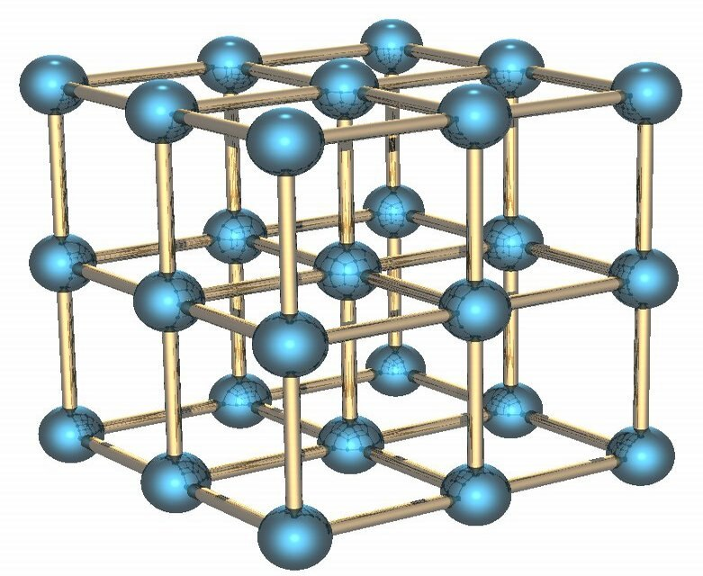
Introduction
3D Simple Cubic Lattice Structure
Wikipedia

Slide 3
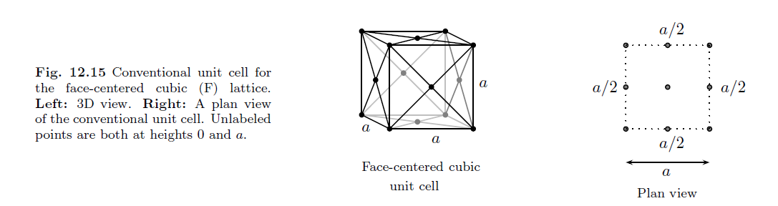
Introduction
3D Cubic Lattice Structure+Surface Diagonal Springs (Add Surface Diagonals Springs, but not the fcc atom!)
The Oxford Solid State Basics, Steven H. Simon(2013)

Slide 4



Physics Problem
Each atom:
Displacement of each atom:
Position of each atom:
Potential Energy:
X-Y-Z terms
Surface Diagonal terms

Slide 5


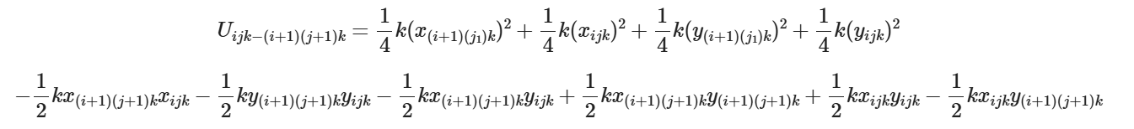
Physics Problem
Small Displacement Approximation

Slide 6
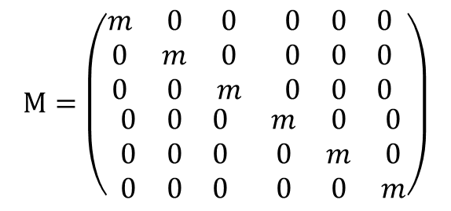
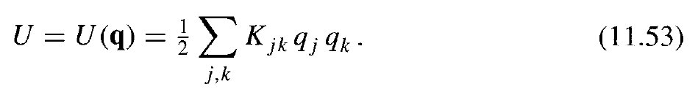
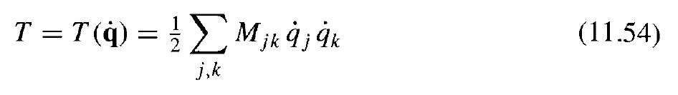
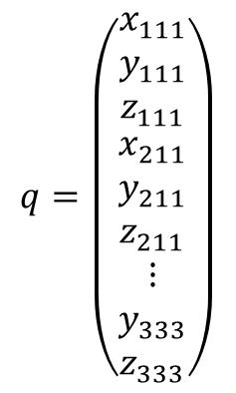

Physics Problem
$$q=\left(\begin{matrix}\begin{matrix}x_{111} \\ y_{111} \\ z_{111}\end{matrix} \\ \begin{matrix}x_{211} \\ y_{211} \\ z_{211}\end{matrix} \\ \begin{matrix}⋮ \\ y_{333} \\ z_{333}\end{matrix}\end{matrix}\right)$$
$$M\ddot{q}=−Kq$$

Slide 7
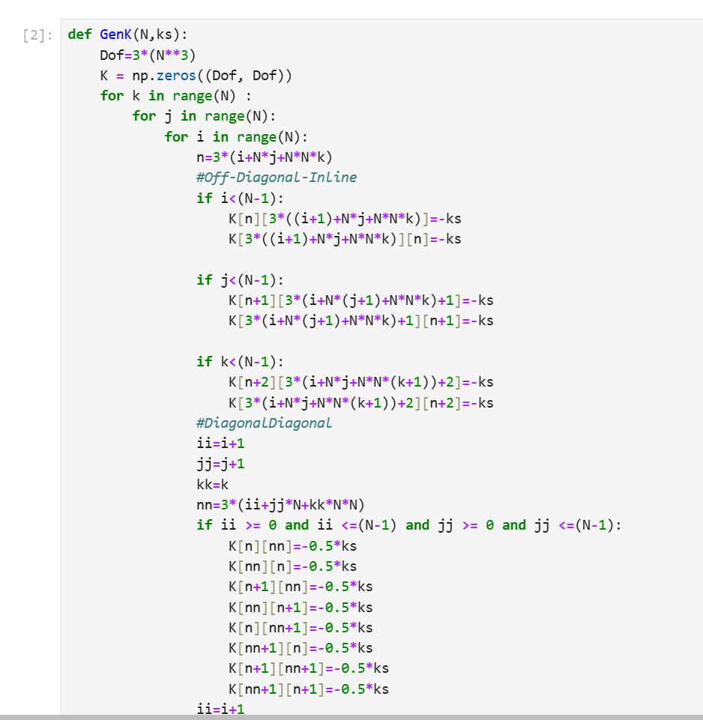
Physics Problem
…...

Slide 8
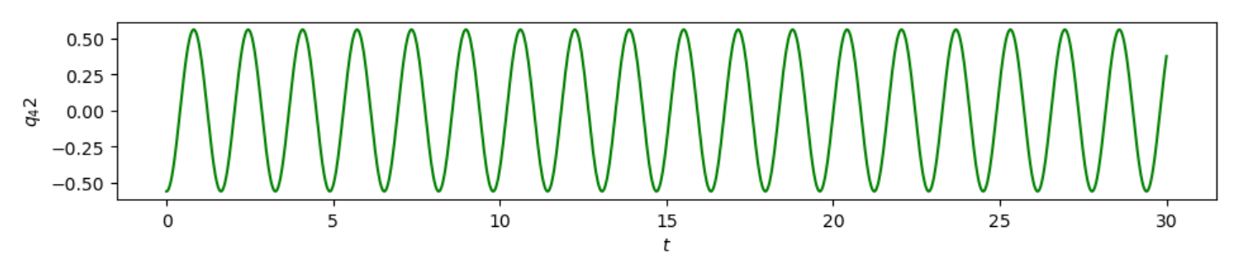
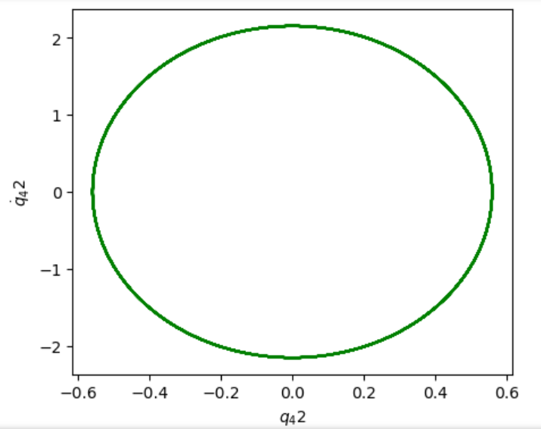
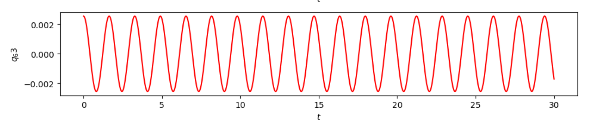
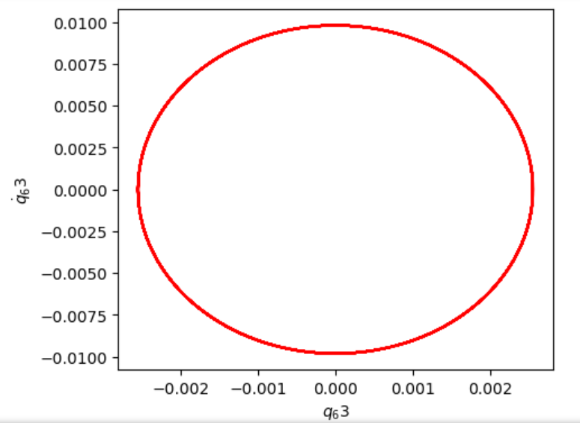
Visualization-Start By 3X3X3
Pick One Normal Mode
81th Mode w=3.847

Slide 9
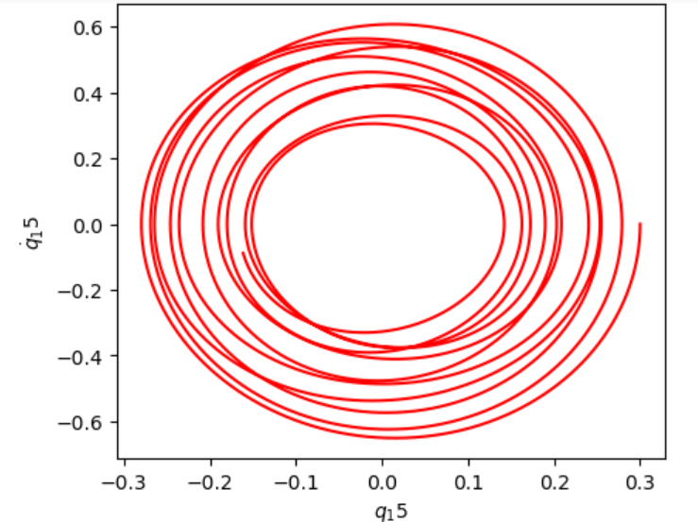
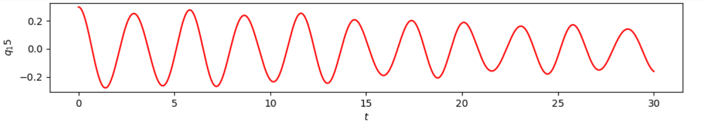
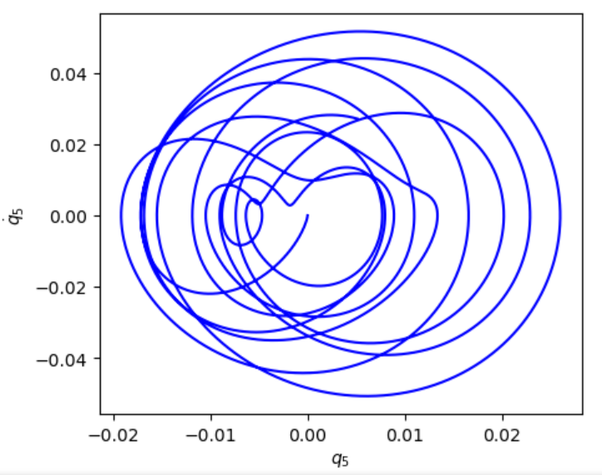
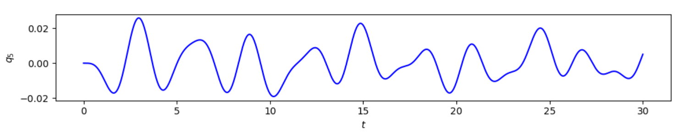
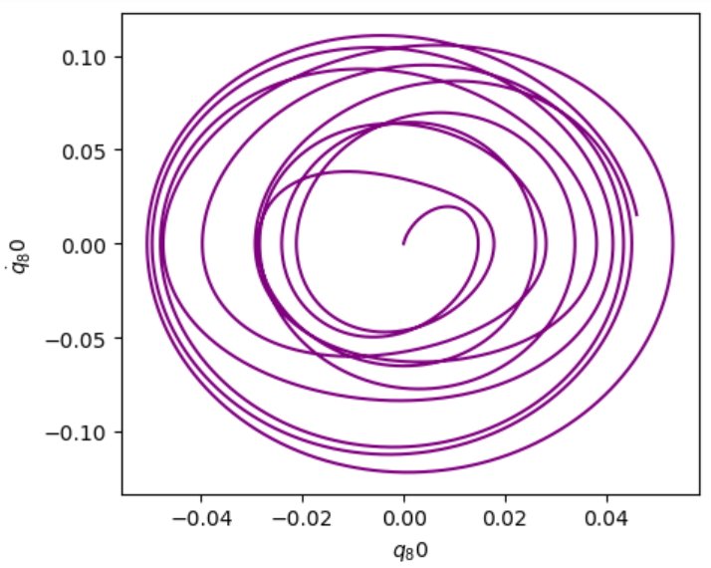
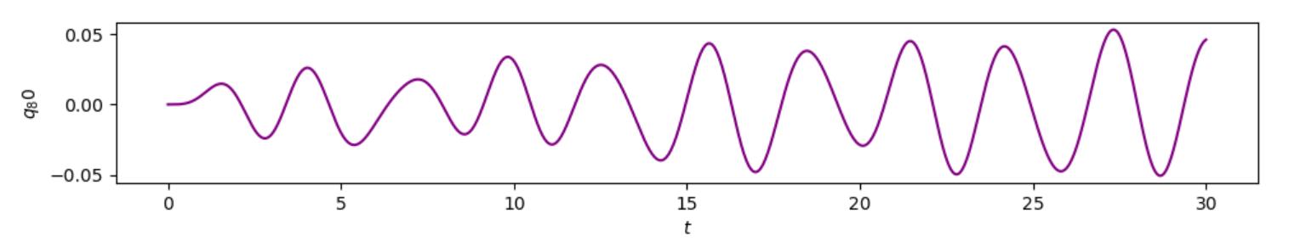
Visualization
Perturbation - Central Upper Atom and Central Lower Atom
The One being Perturbed
Others

Slide 10
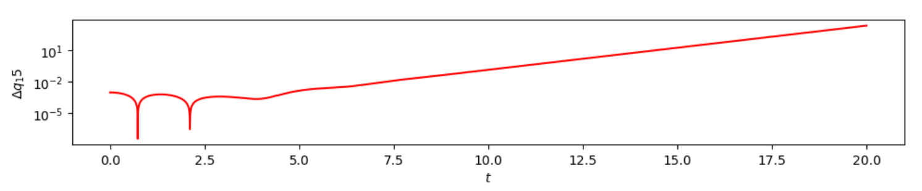
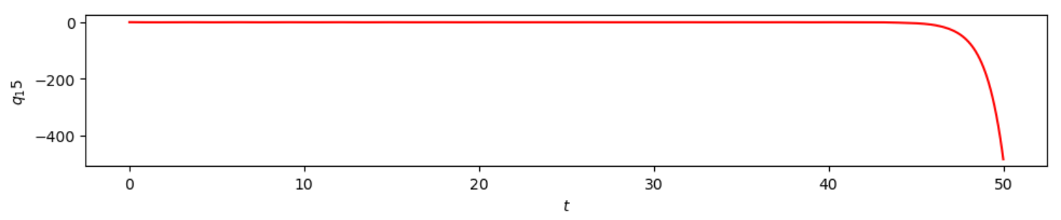
Nonchaotic and Integration Error
Perturbation - Central Upper Atom and Central Lower Atom
The One being Perturbed
Liapunov Plot
Large time

Slide 11
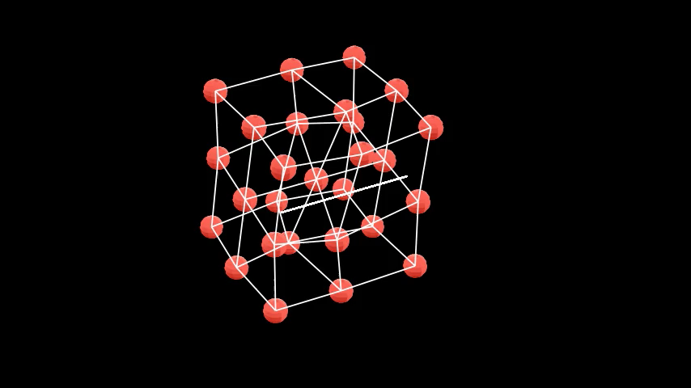
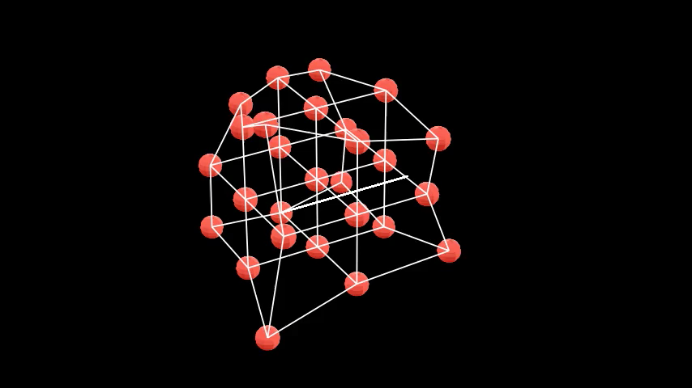
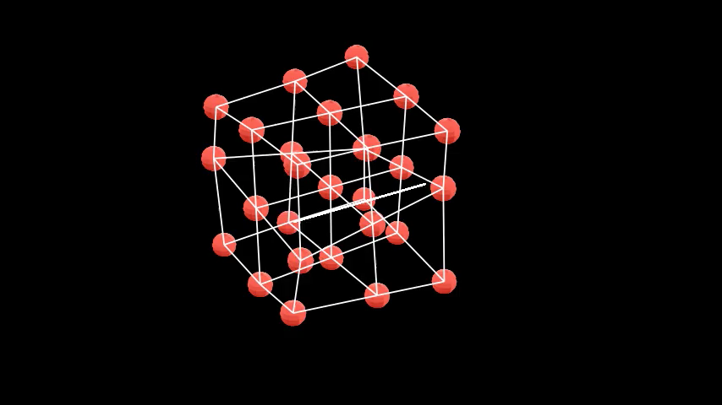
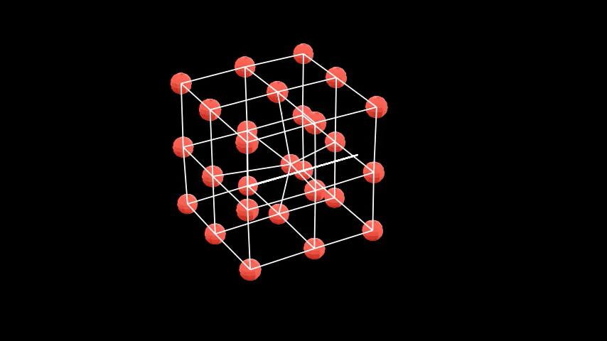
Animation
4th Mode w=0.1054
25th Mode w=1.225
67th Mode w=2.331
81th Mode w=3.847

Slide 12
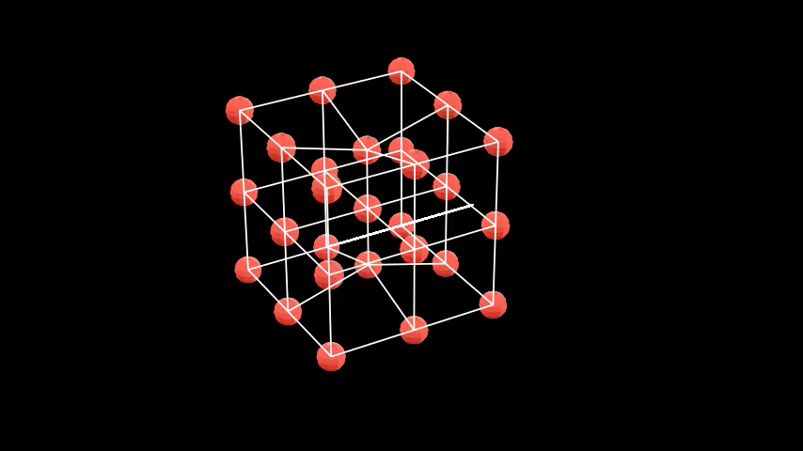
Animation
Perturb Central Upper Atom and Central Lower Atom

Slide 13
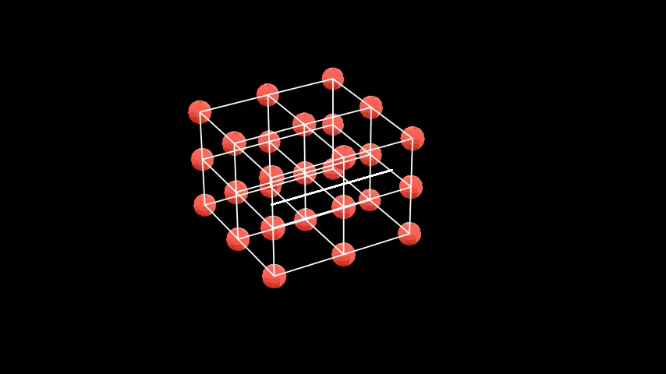
Animation
Perturb Upper Plane and Lower Plane(Squish it!)

Slide 14
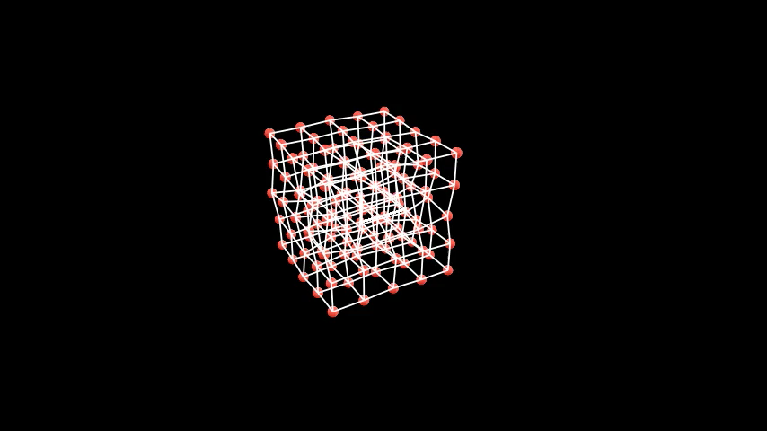
Going Large (5X5X5)
29th Normal Mode w=0.4831

Slide 15
Works Might Needs (Before Friday)
Energy Conservation...
Checks on K matrix...
Maybe Leapfrog helps...

Slide 16
Thanks!

